Slide 1
Applications of Gauss’ law

Slide 2
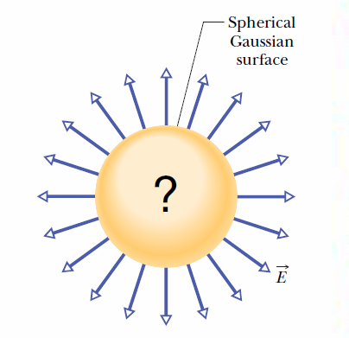
Gauss’ law relates the electric fields at points on a (closed) Gaussian surface to the net charge enclosed by that surface.
Consider the flux passing through a closed surface and the amount of charge inside.

Slide 3
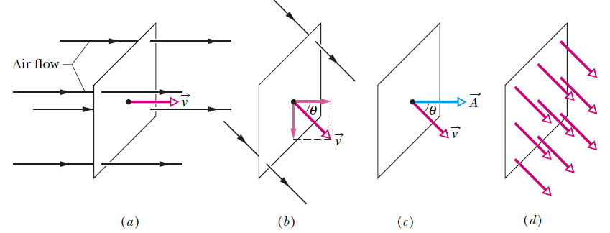

Flux
Fig. 23-2 (a) A uniform airstream of velocity is perpendicular to the plane of a square loop of area A. (b) The component of perpendicular to the plane of the loop is v cos θ, where θ is the angle between v
and a normal to the plane. (c) The area vector A is perpendicular to the plane of the loop and makes an angle θ with v. (d) The velocity field intercepted by the area of the loop. The rate of volume flow through the loop is Φ= (v cos θ)A.
This rate of flow through an area is an example of a flux—a volume flux in this situation.
# The actual physical quantity referred to by the term ‘flux’ can be different in different occasions.

Slide 4
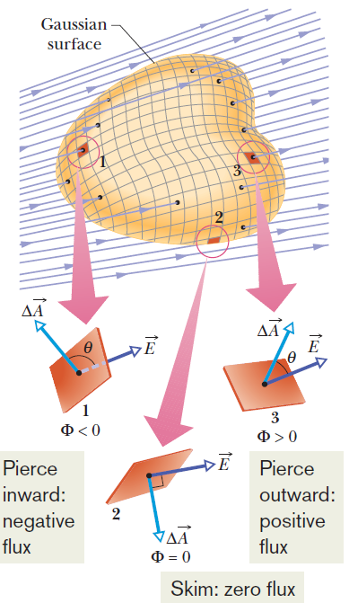

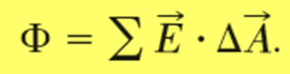
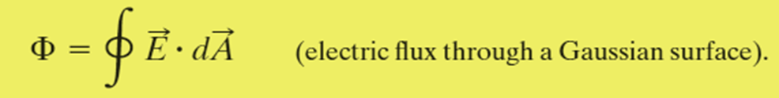
Electric Flux
The electric flux through a surface is defined to be the inner product of the electric field and the surface vector:
For a closed surface, it is

Slide 5
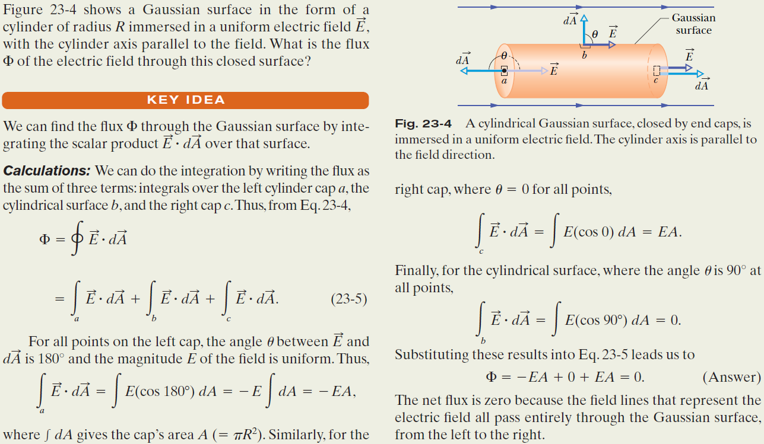
Example, Flux through a closed cylinder, uniform field:

Slide 6
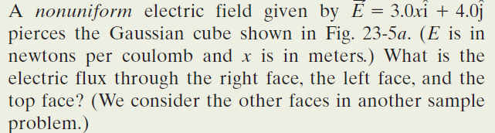
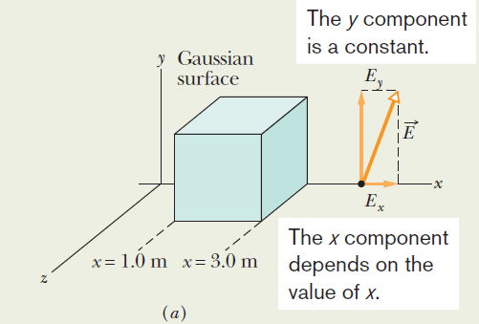

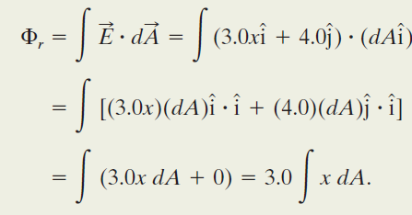


Example, Flux through a closed cube,
Non-uniform field:
Right face: An area vector A is always perpendicular to its surface and always points away from the interior of a Gaussian surface. Thus, the vector for any area element dA (small section) on the right face of the cube must point in the positive direction of the x axis. The most convenient way to express the vector is in unit-vector notation,
Although x is certainly a variable as we move left to right across the figure, because the right face is perpendicular to the x axis, every point on the face has the same x coordinate. (The y and z coordinates do not matter in our integral.) Thus, we have

Slide 7
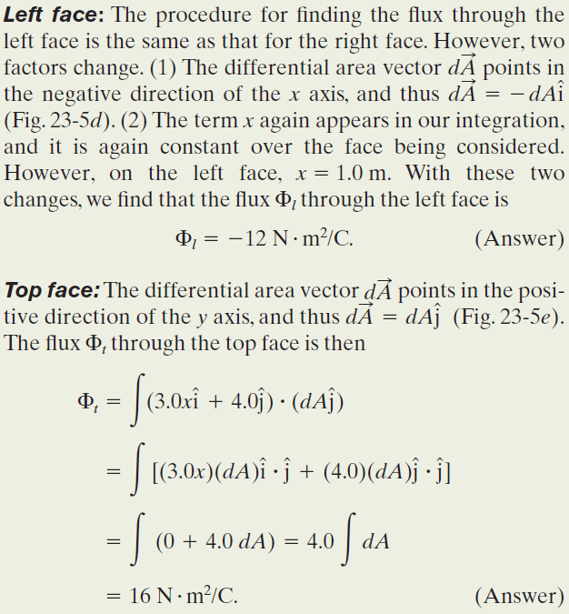
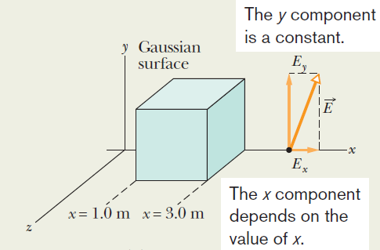
Example, Flux through a closed cube,
Non-uniform field:

